Slide 1

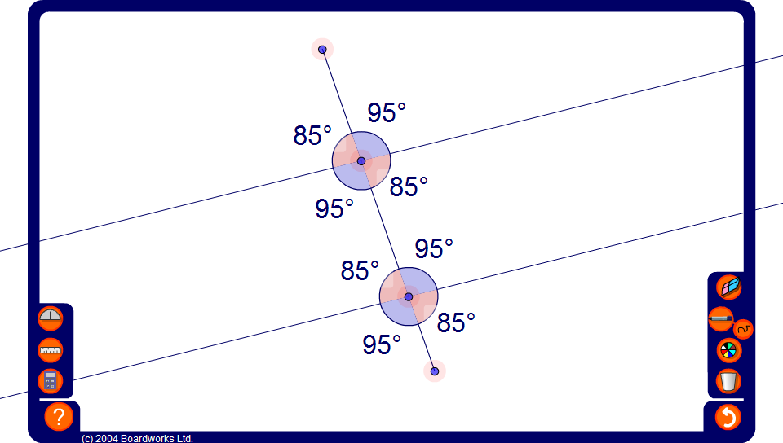


Angles made with parallel lines
Notes:
Use this activity to show that when a line crosses a pair of parallel lines eight angles are produced. The four acute angles are equal and the four obtuse angles are equal. The obtuse angle and the acute angle form a pair of supplementary angles.
Hide all but one of the angles, move the end points to change the angles and ask pupils to find the value of each hidden angle.

